Slide 1
L18 Business and Financial Plan final presentation
Notes:
Each out-of-hours activity must have a cover

Slide 2
L18 Description of the activity
Formally dressed the teams will present the final business and financial plans to an audience compound by the jury (faculty members of the UPC, Programa Innova members, corporate analysts and investors) and the rest of the class.
They will have 20-25 minutes max for the presentation and 20 more minutes to answer questions and challenges from the Jury.
The innovation of the idea (macrotrend, technology and ethics) as well as the innovation of the marketing and technological parts of the BP need to be clearly expressed.
The financial plan presentation has to be deep and comprehensive and the value proposal for investors need to be crystal clear.
More instructions will be given by the professor during the sessions prior to ninth Lab.
Notes:
Ask them to put themselves in a director or businessman place, even if it is only in a fictitious way.

Slide 3
VBP. Evaluation Chart
All students must be organized in teams of three / five people
All students must attend at least 11 out of 15 sessions in total including the three sessions to present the research paper evolution
Session | Final Grade from 0 to 10
Lab 6 and Lab 10 IRBI & mark Plan | 35%
Lab 18 Bus PL presentation | 40%
Quality Overall business model There might be a small final upgrade (up to +0,6 points) based on the quality of the teams’ driven lecture | 25%

Slide 4
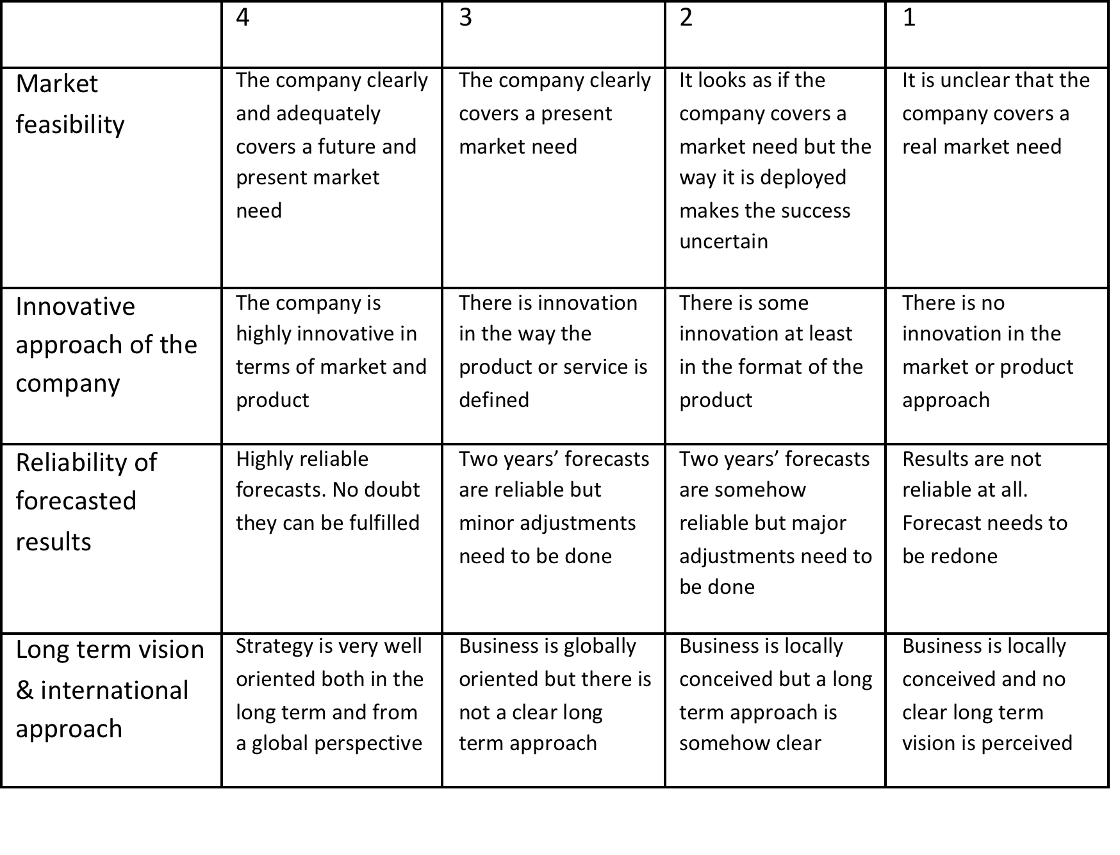
VBP. Details of the evaluation L9 and Quality overall plan I
Economical Feasibility (VBP: 45%)

Slide 5
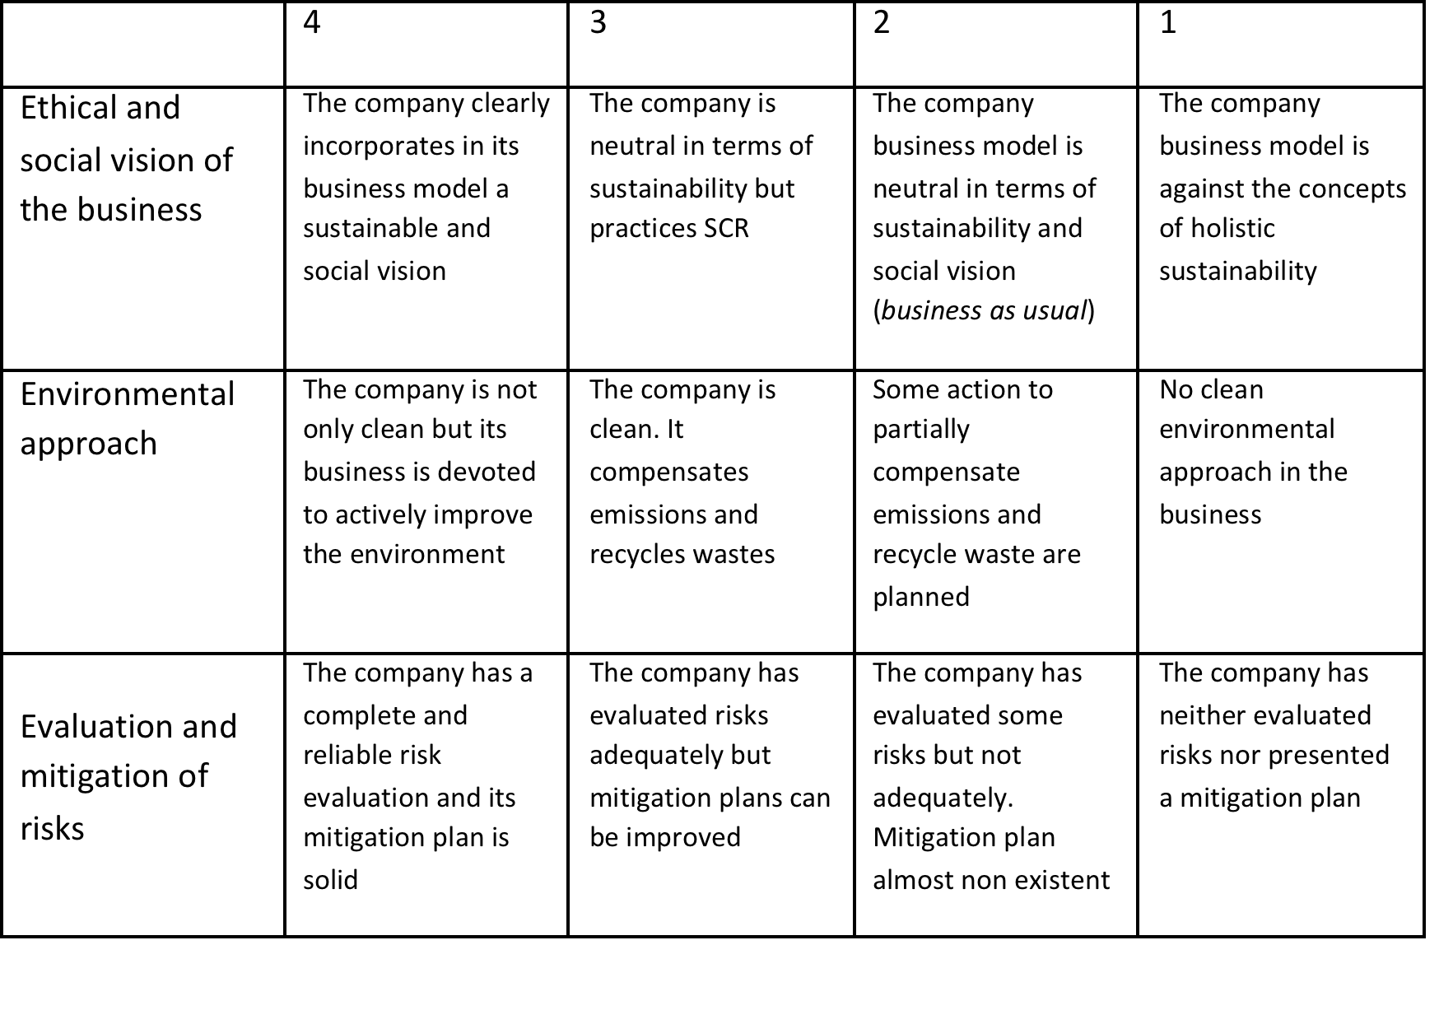
VBP. Details of the evaluation L9 and Quality overall plan II
Impact (VBP: 35%)

Slide 6
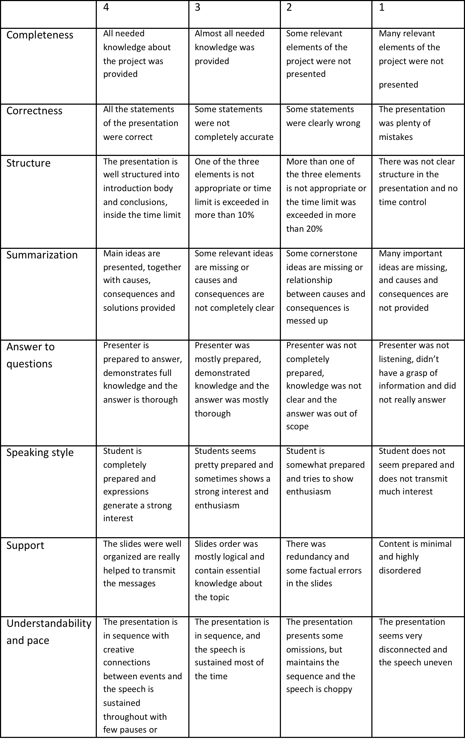
VBP. Details of the evaluation L9 and Quality overall plan III
Presentation (VBP: 20%)

Slide 7
L18 Time and deliverables.
Aprox 6 hours in total. Teams will present their BP but they will also attend other teams' presentations.
Delivery of the business and financial plan by each team for evaluation purposes.
Notes:
Use this time to begin searching a team. … And see you soon.

